Slide 1
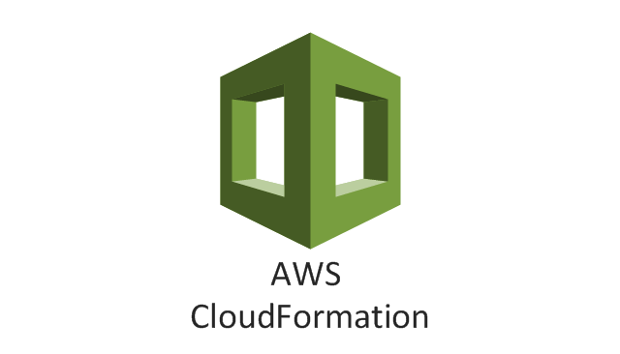

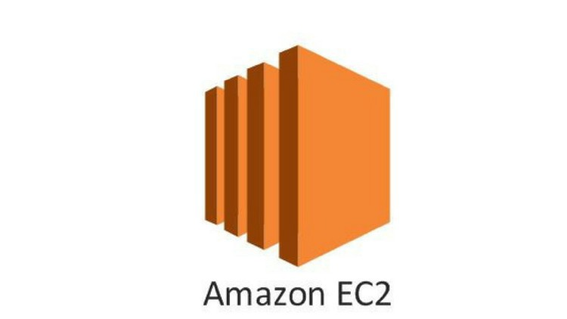
Serverless
IaaS
BaaS

Slide 2





Speed to market
Low infrastructure cost
Scalability and Reliability
Usage based cost

Slide 3
The Evolution
+
Public Cloud
Functions
Nano Services
Private Cloud
Containers
Microservices
Shared Data Centres
Virtual Machines
N-Tier Apps
Data Centres
Physical Servers
Monolithic
Hosting Hardware
Computational Units
Architecture Styles

Slide 4
Nano Services
Do one thing
Nano Services
Serverless
Repo
Be more useful than the cost incurred
Algorithms
Async Event Based Triggers

Slide 5
handler( )
main()

Slide 6
FAAS
controllers
services
handler( )
Logging
daos
Error Handling

Slide 7
Cloud
Formation
Zip
IDE
Upload to S3
Maven
Create IAM Roles
Git
Create Resources
Deployment
Create Functions
SAM
Configure Permissions

Slide 8
BaaS Service
FaaS Service
Functions
Function
App Process
Function
Server Process
Function

Slide 9
Function
Lambda Service
Lambda Host Environment
Java Virtual Machine
Lambda Java Runtime
Lambda Function

Slide 10
Invocation

Slide 11
Scaling
Reliability
AZ2
Lambda Service
AZ1
AZ3

Slide 12
Limits
1000 executions at a time
4 KB
64 MB for Sync
256 KB for ASync

Slide 13
Pricing
Time rounded to closest milli seconds
And the memory we allocate
GB-Sec
1000000
400000

Slide 14
sam build
SAM
sam deploy
AWS
Cloud
Formation

Slide 15
Create Lambda
Deploy Lambda
Lambda Service
Lambda Host Environment
Invoke Lambda
Python Runtime
Lambda Function

Slide 16
Create Lambda
Deploy Lambda
Lambda Service
Lambda Host Environment
Invoke Lambda
Java Virtual Machine
Lambda Java Runtime
Lambda Function

Slide 17
Create IAM User
AWS CLI
AWS SAM CLI
Install Java
Install Eclipse
Install Maven

Slide 18
Invocation
Console
AWS
AWS CLI
SDK

Slide 19
Microservices
Messaging

Slide 20
EC2
EBS
S3

Slide 21
Kinesis
DynamoDb

Slide 22
Chatbots
Alexa

Slide 23
EC2
CloudWatch
S3
Bucket
Cloud
Formation
S3

Slide 24
API Gateway as Event Trigger

Slide 25
S3 as Event Trigger

Slide 26
Sync
API Gateway
Alexa
CloudFront
Lambda Service
Kinesis Data Streams
Lambda Host Environment
Java Virtual Machine
Dynamo DB Streams
Lambda Java Runtime
Lambda Function
Polling
SQS
ASync
S3
SNS
CloudFormation

Slide 27
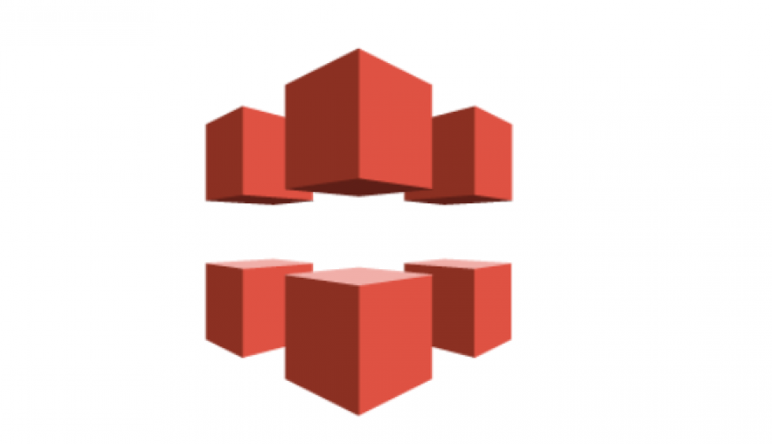

Scaling
Security

Slide 28

patientData.json
v1
patientData.json
v2
Bucket Name
Key

Slide 29
Attributes
firstName | lastName | ssn | email
Item
Keys
Partition Key
Sort Key

Slide 30
API Gateway as Event Trigger
Create Customer
Get Customers

Slide 31
API Gateway as Event Trigger
Customer
firstName
lastName
rewardPoints

Slide 32
S3 as Event Trigger
Student
rollNo
name
testScore
grade

Slide 33
S3 as Event Trigger
ReportGenerator
GradeCalculator

Slide 34
Async Function
Sync Function
truckTracker
getTicket
Latitude
Payment
Longitude
Ticket

Slide 35
Cold Start
Lambda Service
Lambda Host Environment
Java Virtual Machine
Lambda Java Runtime
Lambda Function

Slide 36
When
Deployed or Changed
Instances Expired
Time Taken
Removed due to age
Scaling

Slide 37
Logging
Function
Log Group
Instance1
Log Stream1
Instance2
Log Stream2

Slide 38
Error Handling
Sync
Return a nice error
Lambda Service
Kinesis Data Streams
Lambda Host Environment
Dynamo DB Streams
Python Runtime
Lambda Function
Polling
SQS
Failure Handling
Retries
Log
ASync
DeadLetterQueue/Destination
Lambda Function

Slide 39
Lambda Service
Event
Source
Lambda Host Environment
Java Virtual Machine
Lambda Java Runtime
Lambda Function
Event
Source
Threads
Library
Threads
Event
Source
Lambda Host Environment
Java Virtual Machine
Lambda Java Runtime
Lambda Function

Slide 40

SQS
aSync
Lambda
Service
messageId

Slide 41
Batch
Visibile
Lambda
Service

